Slide 1
EYFS

Slide 2
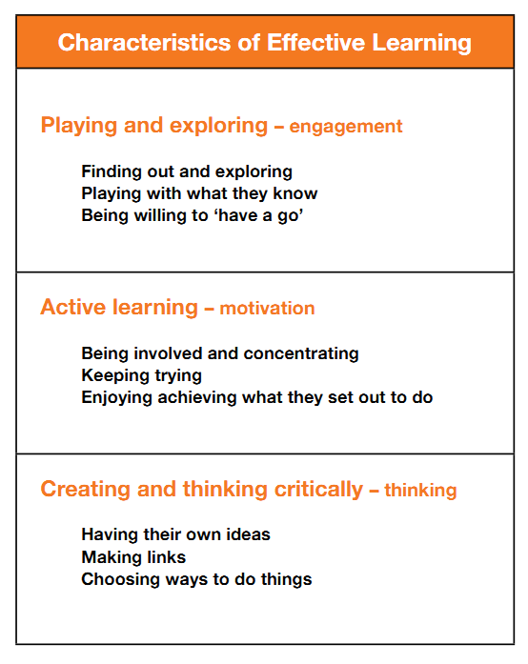
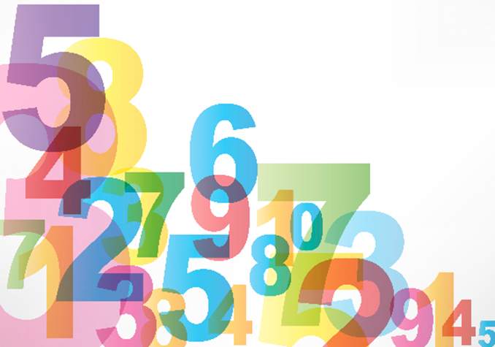
Number
Shape, Space and Measure
It is taught inside and outside!

Slide 3
- Look in detail at the ELG.
- Explore problems the children may need to solve.
Please ask questions and
we’ll try and answer.

Slide 4
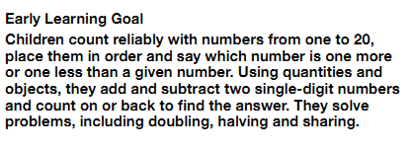
Number
Age Related Expectation

Slide 5
Use rhymes, songs and stories involving counting on and counting back in ones, twos, fives and tens.
Show interest in how children solve problems and value their different solutions.
Talk about the methods children use to answer a problem they have posed, e.g. ‘Get one more, and then we will both have two.
Encourage children to extend problems, e.g. “Suppose there were three people to share the bricks between instead of two”.
resources

Slide 6
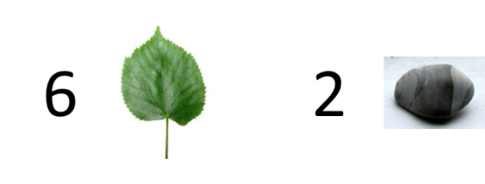
Children count reliably with numbers from one to 20, place them in order and say which number is one more or one less than a given number.
Washing line
Can they put them in order?
Can they match objects to them?
Can they talk about which one is one more than ….?
Jumping
How many jumps did you do?
Can you jump along the number line?
What number did you land on?
Can you find…?
Send children on nature hunt.

Slide 7
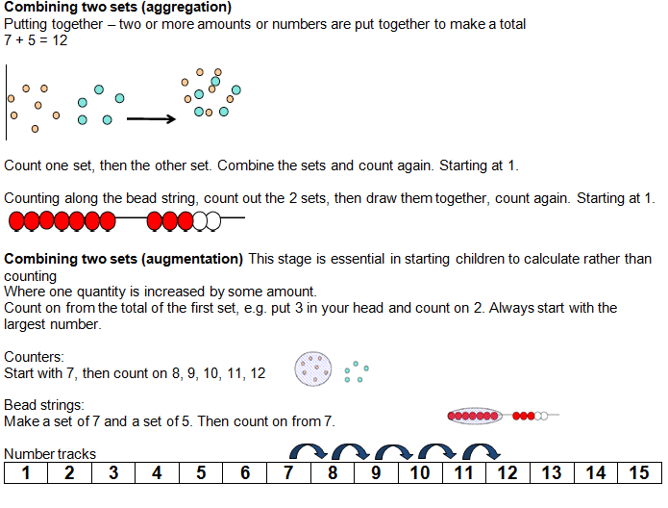
Using quantities and objects, they add and subtract two single-digit numbers
and count on or back to find the answer.

Slide 8
Using quantities and objects, they add and subtract two single-digit numbers
and count on or back to find the answer.

Slide 9
They solve problems, including doubling, halving and sharing.

Slide 10
They solve problems, including doubling, halving and sharing.

Slide 11
Shape, Space and Measure
Age Related Expectation

Slide 12
Ask ‘silly’ questions, e.g. show a tiny box and ask if there is a bicycle in it.
Play peek-a-boo, revealing shapes a little at a time and at different angles, asking children to say what they think the shape is, what else it could be or what it could not be.
Be a robot and ask children to give you instructions to get to somewhere. Let them have a turn at being the robot for you to instruct.
Introduce children to the use of mathematical names for ‘solid’ 3D shapes and ‘flat’ 2D shapes, and the mathematical terms to describe shapes.
Encourage children to use everyday words to describe
position, e.g. when following pathways or playing with
outdoor apparatus.
resources

Slide 13
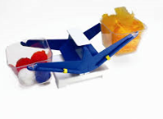
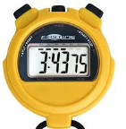
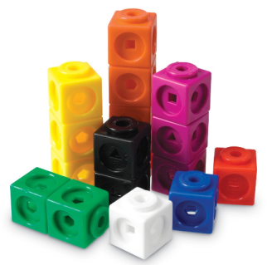
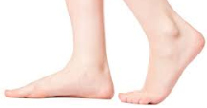
Children use everyday language to talk about size, weight, capacity, position, distance, time and money to compare quantities and objects and to solve problems.
They are encouraged to use
equipment of their choice
to solve problems!

Slide 14
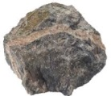
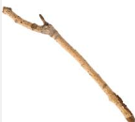
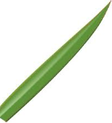
They recognise, create and describe patterns.
What comes next? How do you know?

Slide 15
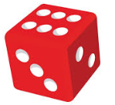
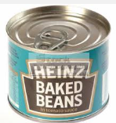
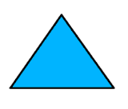
They explore characteristics of everyday objects and shapes and use mathematical language to describe them.
straight
round
sharp
line
curved
flat
pointy
It is important they see real life objects.

Slide 16
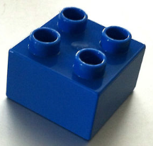
Activities for you! Explore… could you do any of these with your children?
Can you put the duplo in order?
1
Start with the smallest number.
Start with the largest number.

Slide 17
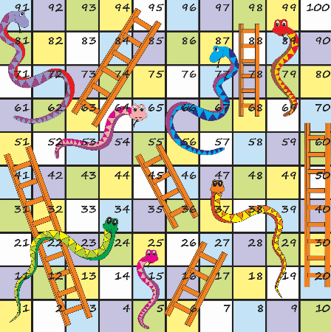
Activities for you! Explore… could you do any of these with your children?
Play games rolling a dice.
1

Slide 18
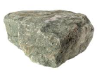
Activities for you! Explore… could you do any of these with your children?
Can you find an object heavier
that stone?
Can you find something lighter?
Can you find something
the same weight?

Slide 19
Activities for you! Explore… could you do any of these with your children?
How many repeated patterns can you make
with 3 different objects?

Slide 20
Activities for you! Explore… could you do any of these with your children?
How many jumps can you do in 10 seconds?
Who can jump the furthest?

Slide 21
Activities for you! Explore… could you do any of these with your children?
How many triangles can you
make with 9 lolly sticks?

