Slide 1
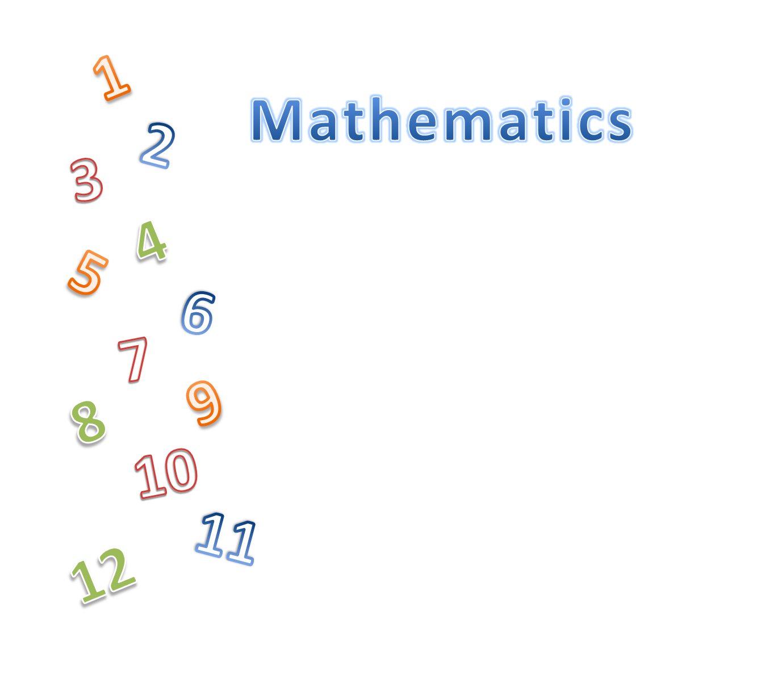
KS1
'The national curriculum for mathematics aims to ensure that all pupils:
become fluent......
reason mathematically.....
and can solve problems.'

Slide 2
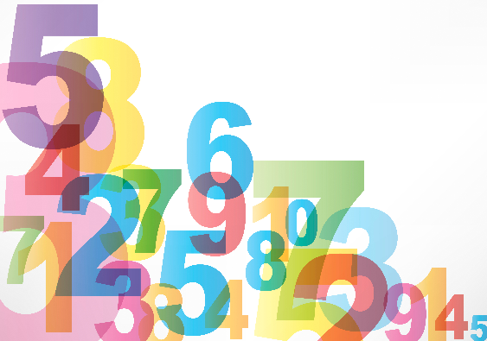
Year 1
6 + 7 = 12
7 + 9 + 1 = 17
It is your turn!
Am I correct? How do you know?
I know 6 + 6 = 12 so
1 more would be 13.
I know 9 + 1 = 10
So 7 more is 17.

Slide 3
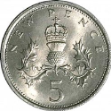
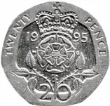
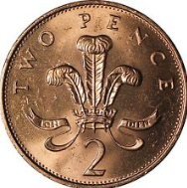
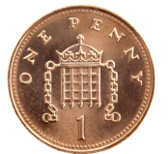
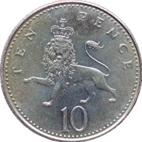
Year 2
It is your turn!
How many ways can you make 21p?
You can use each coin more than once!

Slide 4
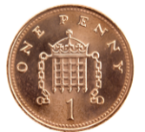

I got to 24 ways and I hadn’t started splitting the final 10p in 1p and 2p!

Slide 5
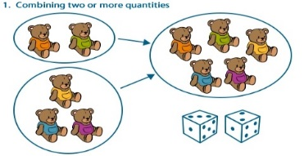
How do we teach the children to add and subtract at Dogsthorpe Infants School?
We try and encourage the children to count on.
8, 9, 10

Slide 6
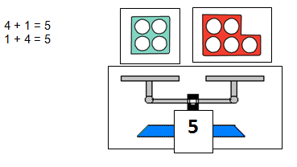
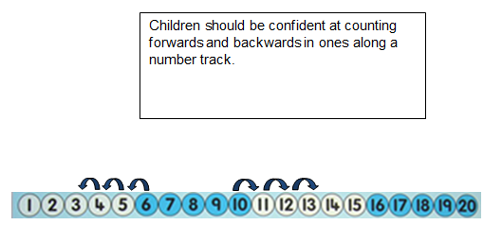
We teach the children that equals means balance. We use scales to make sure our number sentences balance.

Slide 7
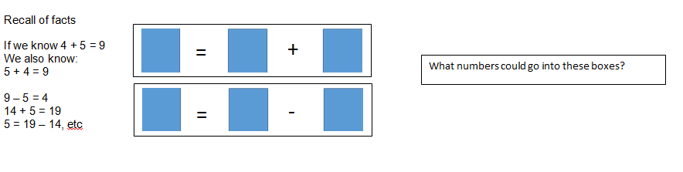
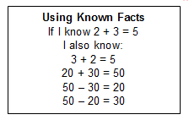
We encourage the children to apply their knowledge in different ways.
By the end of Year 1 children should be able to recall and use facts within and to 20 for addition and subtraction.
Then in Year 2 children should be able to extend their knowledge further.

Slide 8
Year 1
It is your turn!
6
4
2
What do you know?
6 - 2 = 4
4 + 2 = 6
6 - 4 = 2
2 + 4 = 6
They are all even.
6 is the largest and 2 the smallest.

Slide 9
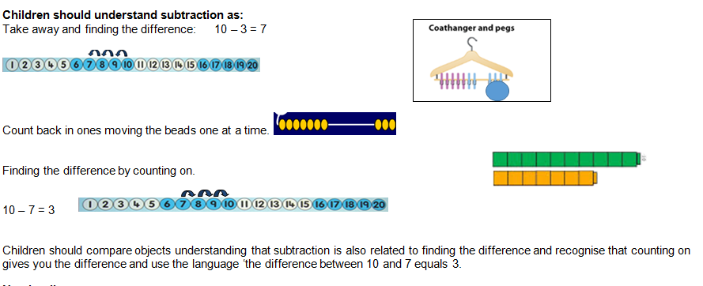

Slide 10
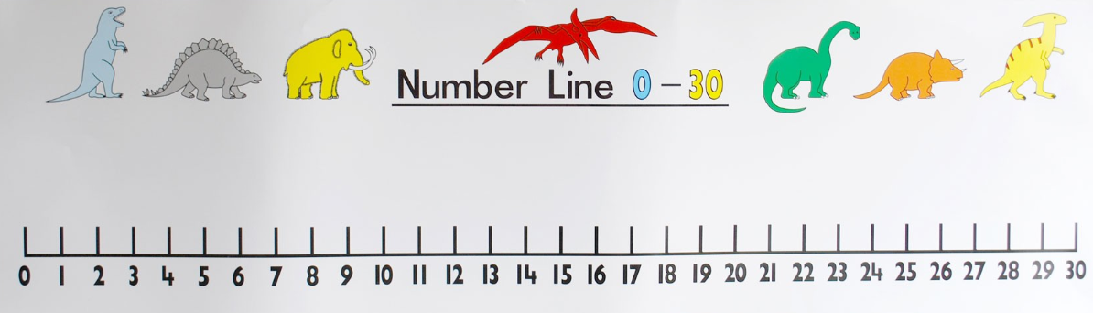
Number lines
4 + 13 =
What is the biggest number?

Slide 11
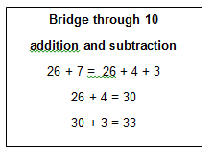
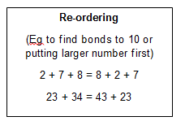
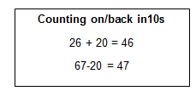
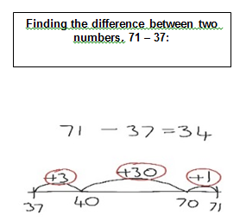
When they get into Year 2 we aim to teach the children these skills to develop their mental skills.
23 + 34 = 34 + 23

Slide 12
Year 2 How would you solve these?
36 + __ = 42
31 + __ + 5 = 46
It is your turn!
What is the missing number? How do you know?
I know 36 + 4 = 40.
It is 2 more.
So 4 + 2 more equals 6.
I know 46 - 5 = 41
The difference between
45 and 35 is 10.

Slide 13
Addition in Year 2 - Partitioning
23 + 34 =
First we would encourage the children to put the largest number first.
34 + 23 =
20 3
Then we would add on the tens
34 + 20 = 54
Then we would add the units
54 + 3 = 57

Slide 14
Activity –
11 + 18 = How would you solve this for your child?
First we would encourage the children to put the largest number first.
18 + 11 =
10 1
Then we would add on the tens
18 + 10 = 28
Then we add the units
28 + 1 = 29

Slide 15
In Year 1 this is what it would look like.

Slide 16
Subtraction in Year 2
37 - 16 =
37 - 16 =
10 6
Then we would subtract the tens
37 - 10 = 27
Then we subtract the units
27 - 6 = 21

Slide 17
Number lines – mainly in Year 1
19 – 4 =
What is the biggest number?

Slide 18
It is your turn!
Year 1 - How would your child solve this?
23 – 8 =

Slide 19
It is your turn!
Subtraction in Year 2
46 – 25 =
46 - 25 =
20 5
Then we would subtract the tens
46 - 20 = 26
Then we subtract the units
26 - 5 = 21

Slide 20
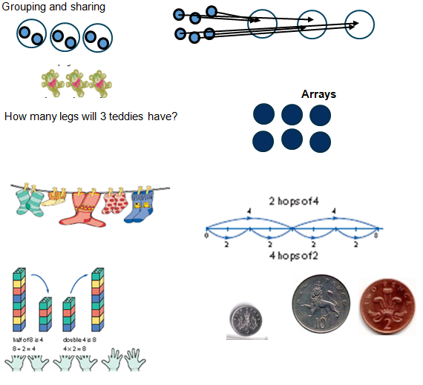
We spend a lot of time exploring problems when solving multiplication and division. We try and use word problems before we introduce the Symbols x or ÷ .
Multiplication and Division in Year 1

Slide 21






Multiplication
They have 2 sweets each.
There are 5 Triceratops. They have 3biscuits each. How many biscuits do they have altogether?

Slide 22



8
Division
I picked up 15 apples from under 3 trees. How many fell off each tree?

Slide 23

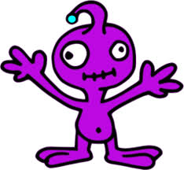





It is your turn!
Socks and shoes
How many pairs of socks do these aliens need?
I have 6 legs.
I have 12 legs.
I have 22 legs.
I have 8 legs.
I have 19 legs.
I have 15 legs.

Slide 24


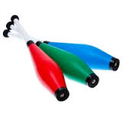
It is your turn!
Jugglers
Sam, Ben, Ian, Jo and Bob are jugglers.
They have a bag of juggling clubs.
On Monday there are 10 clubs in the bag. How many clubs do they have each?
On Tuesday there are 35 clubs in their bag. How many clubs do they have each?
On Wednesday, the jugglers need 5 clubs each. How many
clubs do they need in the bag?
On Thursday, the jugglers need 4 clubs each. How
many clubs do they need in their bag?

Slide 25
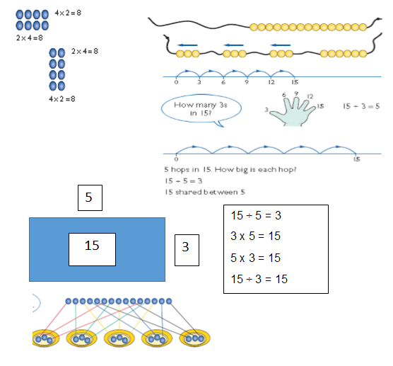
Multiplication and Division in Year 2
We introduce arrays and the symbols in.

